Slide 1
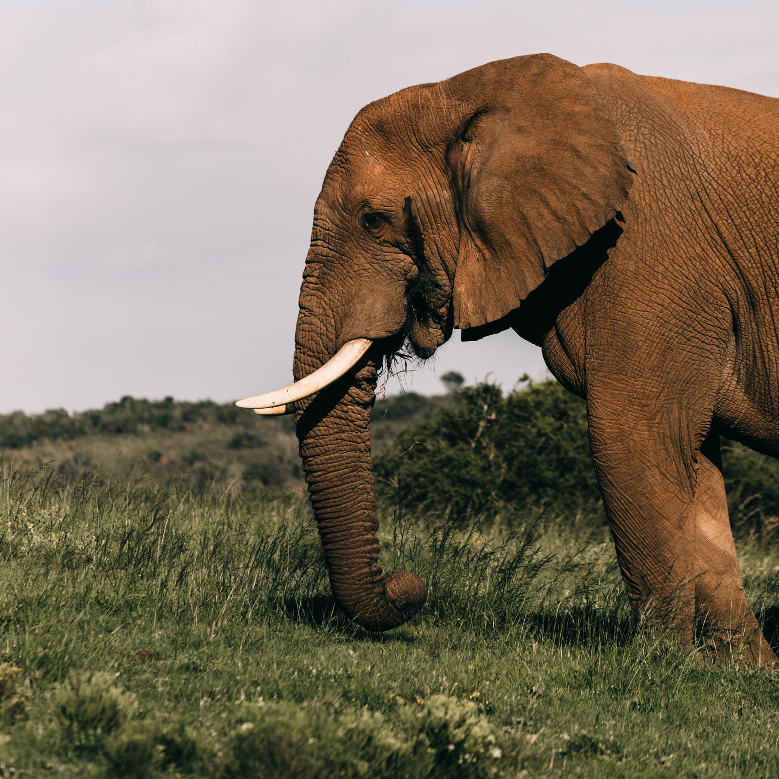
Elephant powerpoint presentation
Download this awesome creatives and bring your presentation to life , with our creativity
Largest mammal in land
This slide is an editable slide with all your needs. Capture your audience attention.
Life span : 60-70 years
This slide is an editable slide with all your needs. Capture your audience attention.
Food : 140-270 kg/day
This slide is an editable slide with all your needs. Capture your audience attention.

